Slide 1
Forms
INT219

Slide 2
Forms
Angular forms are used to handle user's input. We can use Angular form in our application to enable users to log in, to update profile, to enter information, and to perform many other data-entry tasks.
There are 2 approaches to handle user's input through forms:
Template-driven forms
Reactive forms

Slide 3
Template-driven Forms
Template-driven forms are best if you want to add a simple form to your application. For example: email list signup form.
Template-driven forms are easy to use in the application but they are not as scalable as Reactive forms.
Template-driven forms are mainly used if your application's requires a very basic form and logic. It can easily be managed in a template.

Slide 4
Reactive forms
Reactive forms are more robust.
Reactive forms are more scalable, reusable, and testable.
They are most preferred to use if forms are a key part of your application, or your application is already built using reactive patterns. In both cases, reactive forms are best to use.

Slide 5
Reactive forms
Before moving to create Reactive forms, we need to understand about the following concepts:
FormControl − Define basic functionality of individual form control
FormGroup − Used to aggregate the values of collection form control
FormArray − Used to aggregate the values of form control into an array

Slide 6
Form model setup in Template-driven Forms
import { Component } from '@angular/core';
@Component({
selector: 'app-template-favorite-color',
template: `
Favorite Color: <input type="text" [(ngModel)]="favoriteColor"> `
})
export class FavoriteColorComponent {
favoriteColor = '';
}

Slide 7
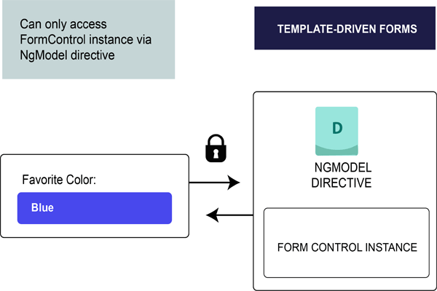
Form model setup in Template-driven Forms
In template-driven forms, the source of truth is template itself.

Slide 8
Form model setup in Template-driven Forms
The form model abstraction promotes simplicity over structure. The template-driven form directive NgModel creates and manages the FormControl instance for a given form element. It's less explicit, but it removes the direct control over the form model.

Slide 9
Form model setup in Reactive forms
import { Component } from '@angular/core';
import { FormControl } from '@angular/forms';
@Component({
selector: 'app-reactive-favorite-color',
template: `
Favorite Color: <input type="text" [formControl]="favoriteColorControl"> `
})
export class FavoriteColorComponent {
favoriteColorControl = new FormControl('');
}

Slide 10
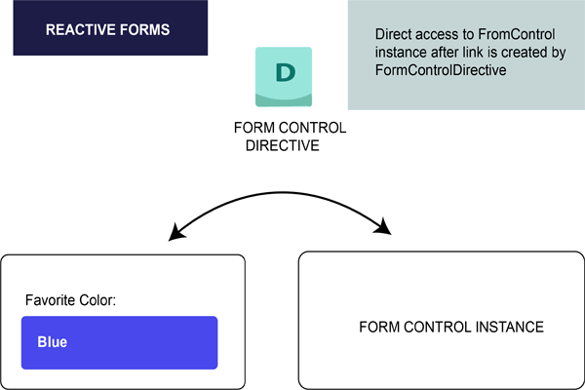
Form model setup in Reactive forms
In reactive forms, the form model is the source of truth. The source of truth provides the value and status of the form element at a given point in time.
Here, in the example above, the form model is the FormControl instance.

